Slide 1
DATA ANALYST INTERNSHIP
BY:-AAKASH RAJPUROHIT
TASK 1:- HR DATA ANALYSIS (SQL)

Slide 2
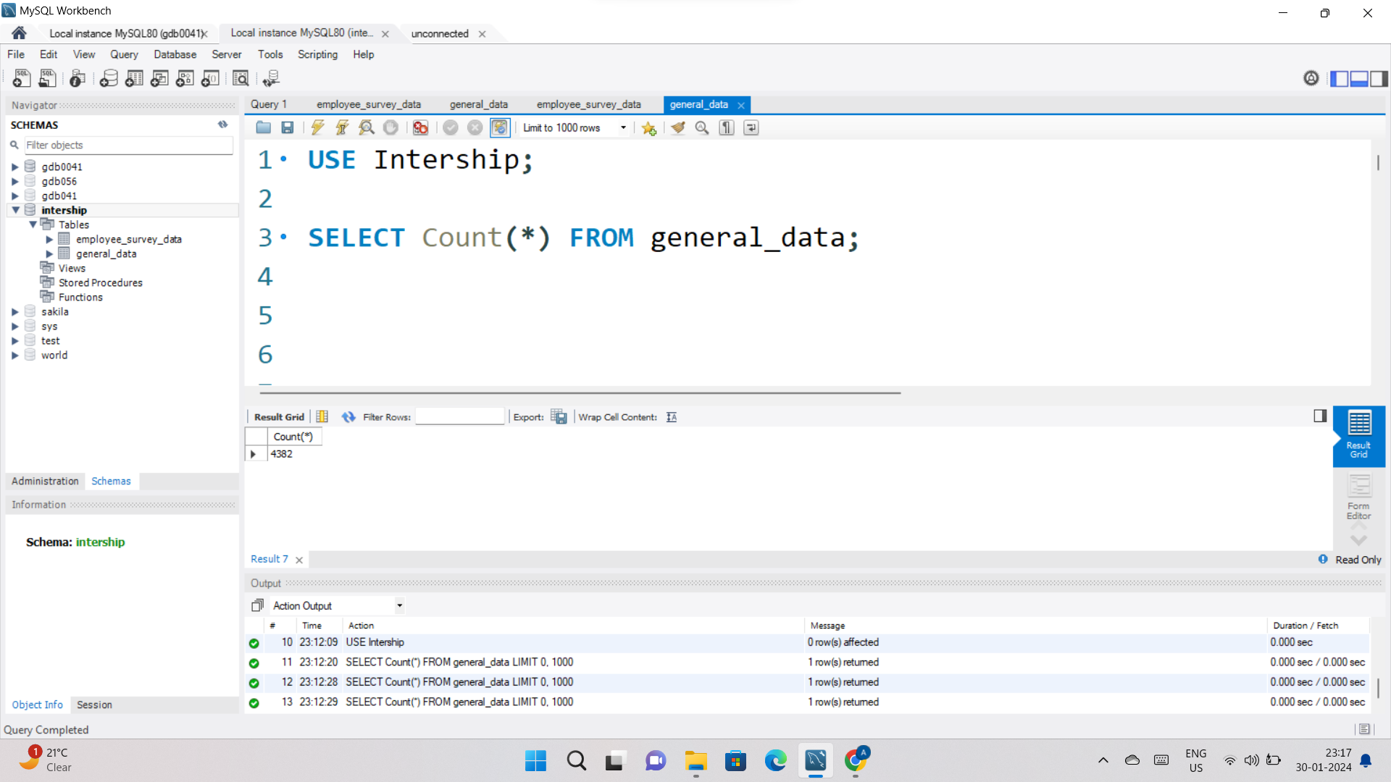
1. Retrieve the total number of employees in the dataset.

Slide 3
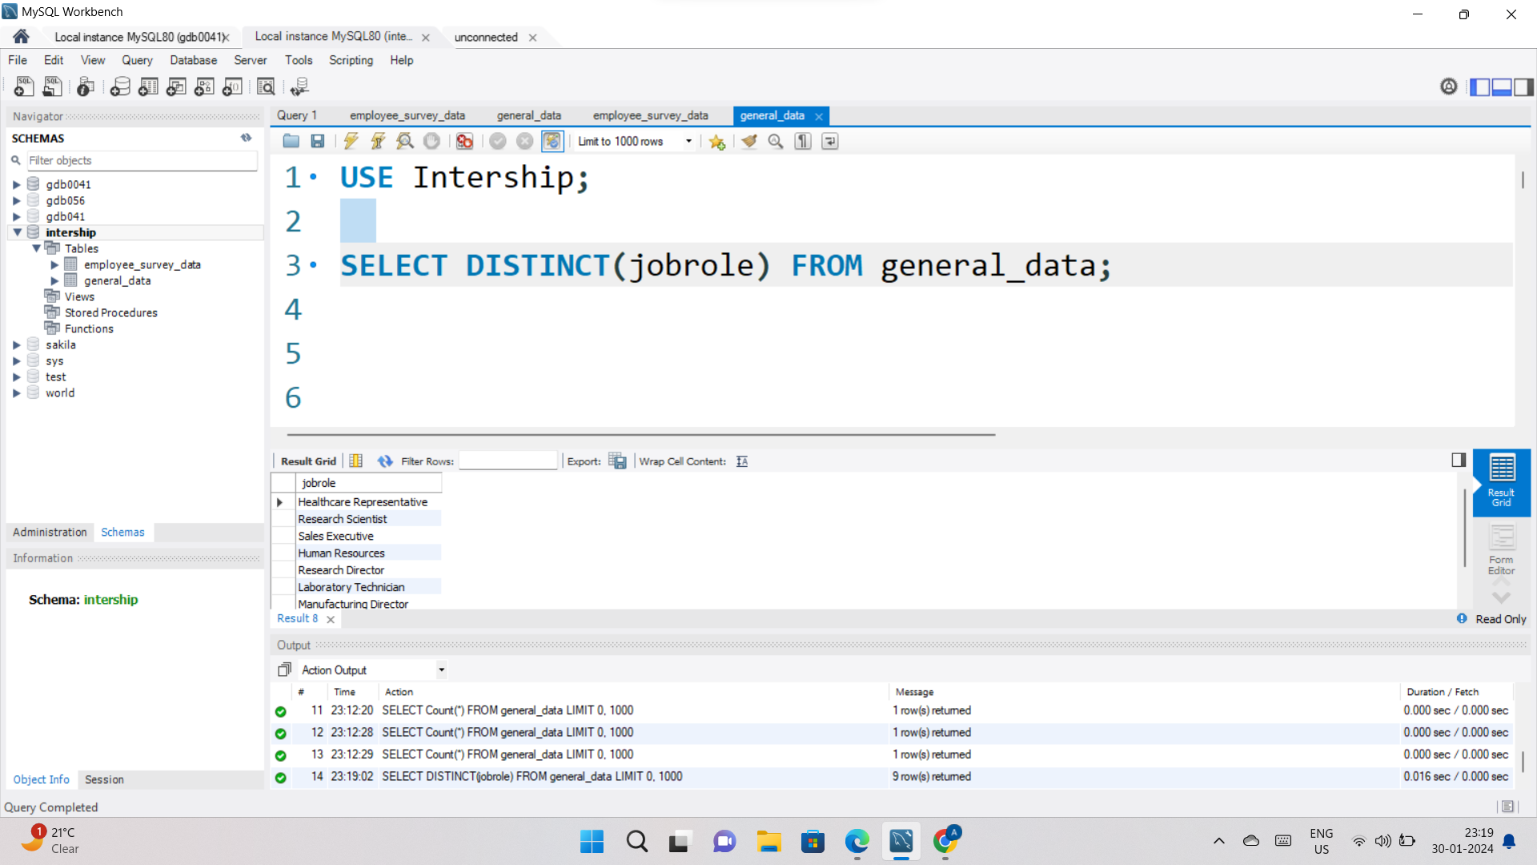
2. List all unique job roles in the dataset.

Slide 4
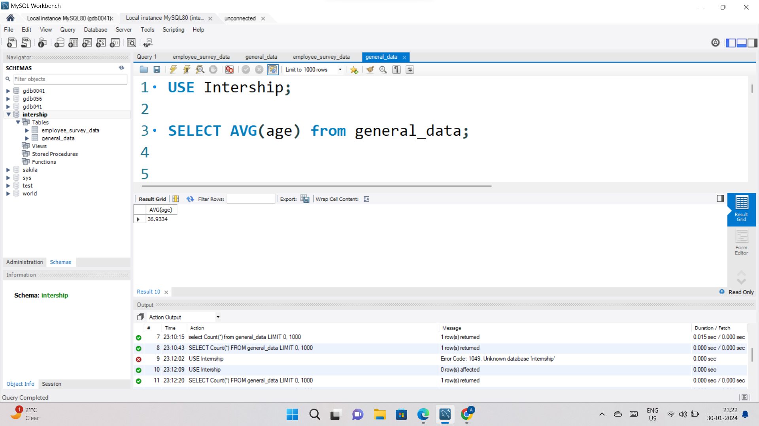
3. Find the average age of employees.

Slide 5
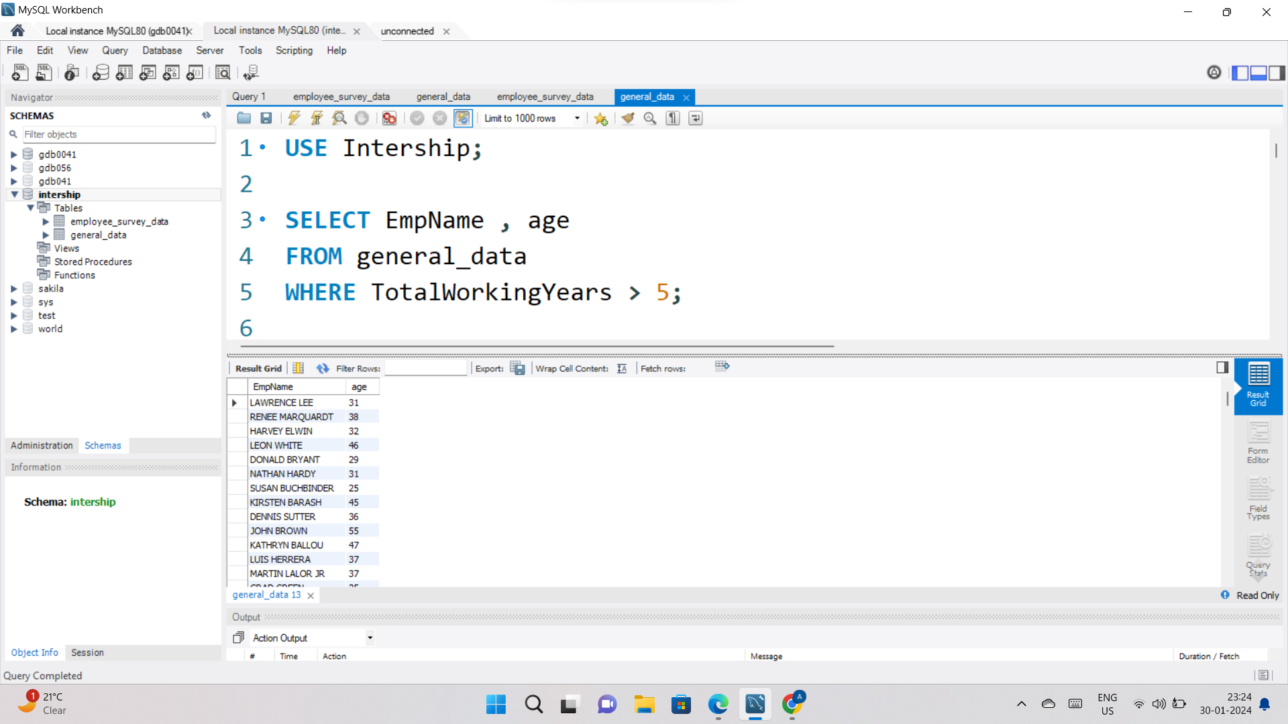
4. Retrieve the names and ages of employees who have worked at the company for more than 5 years.

Slide 6
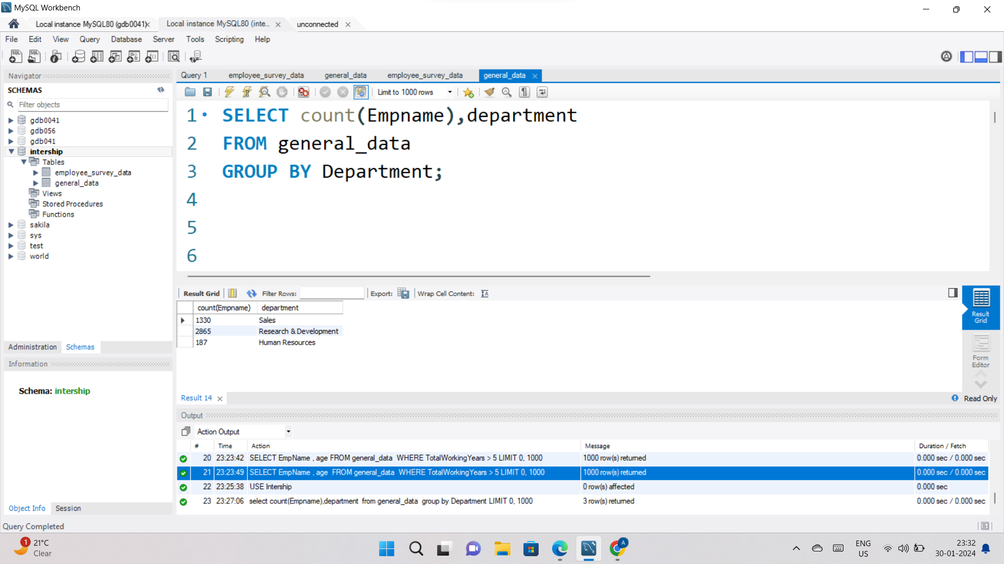
5.Get a count of employees grouped by their department.

Slide 7
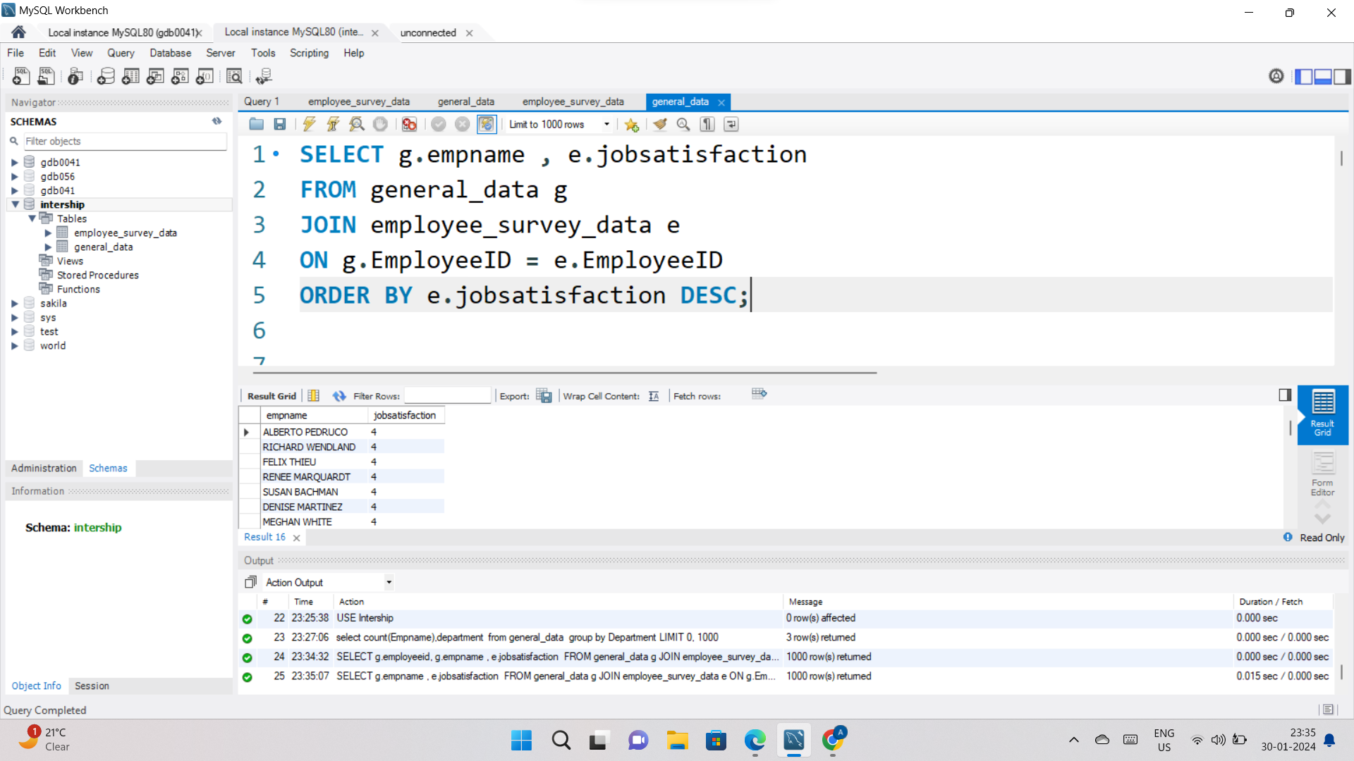
6. List employees who have 'High' Job Satisfaction.

Slide 8
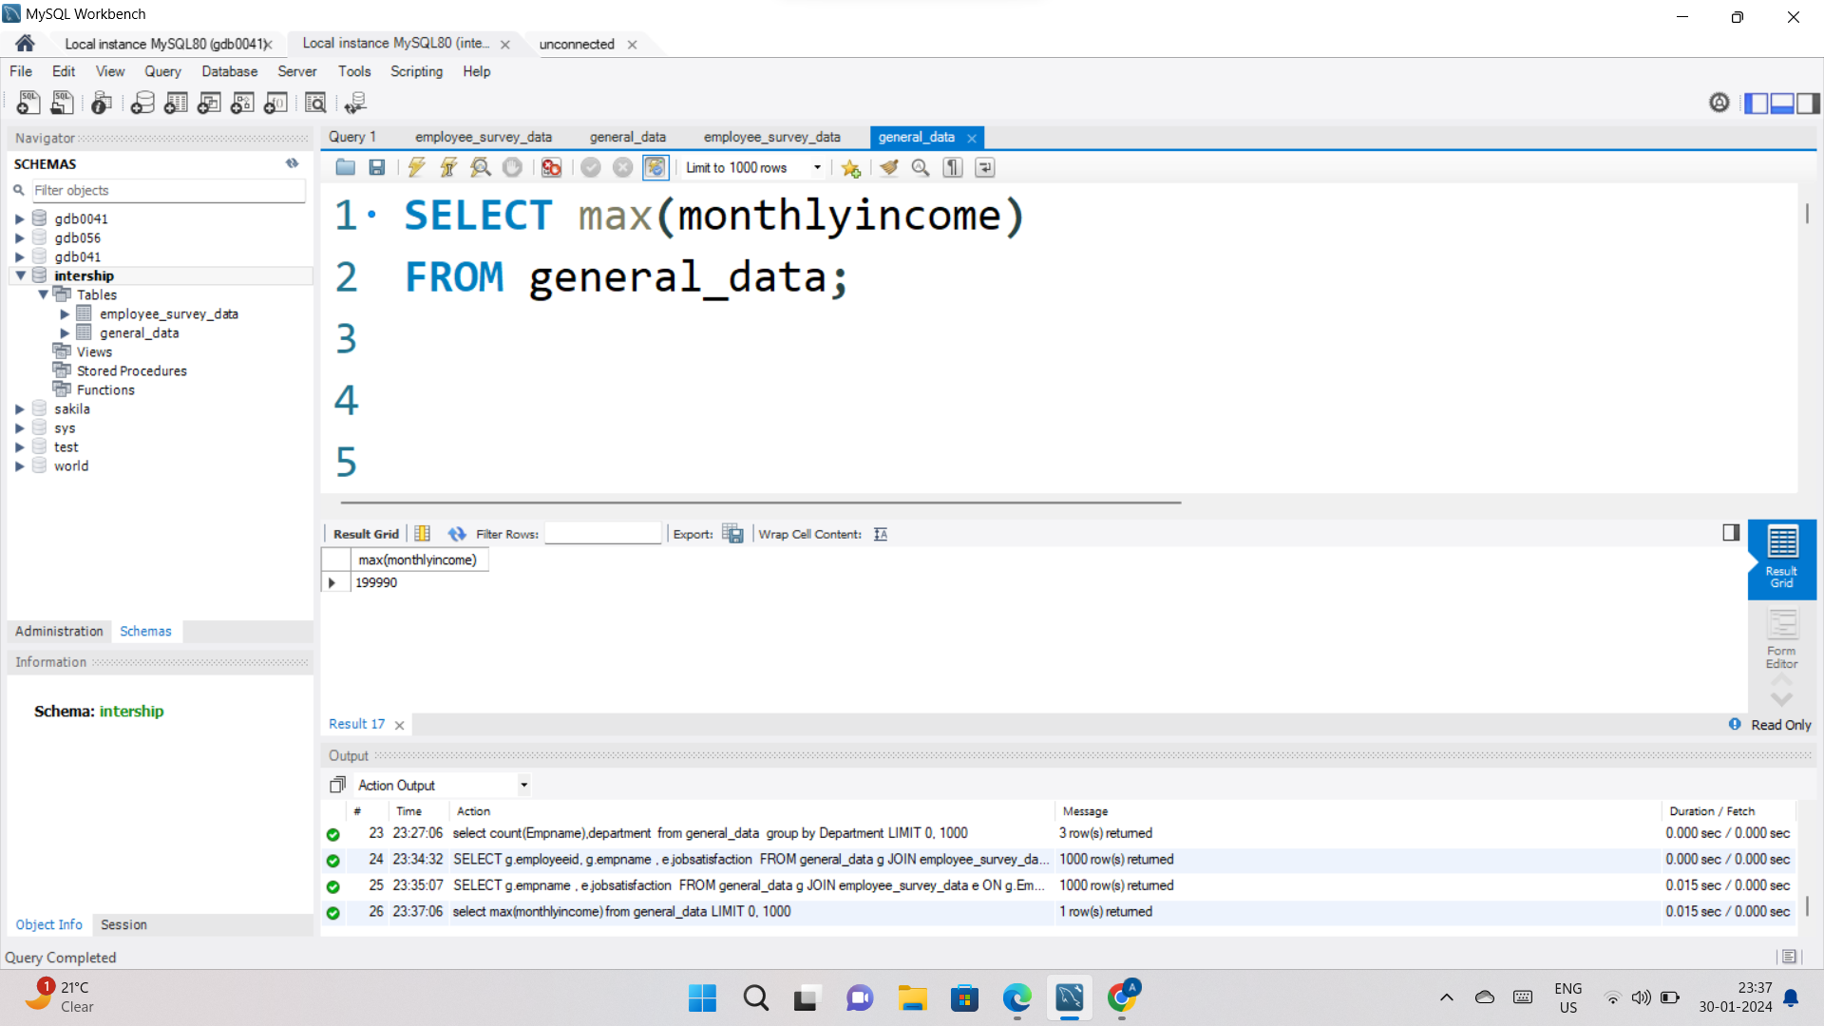
7. Find the highest Monthly Income in the dataset.

Slide 9
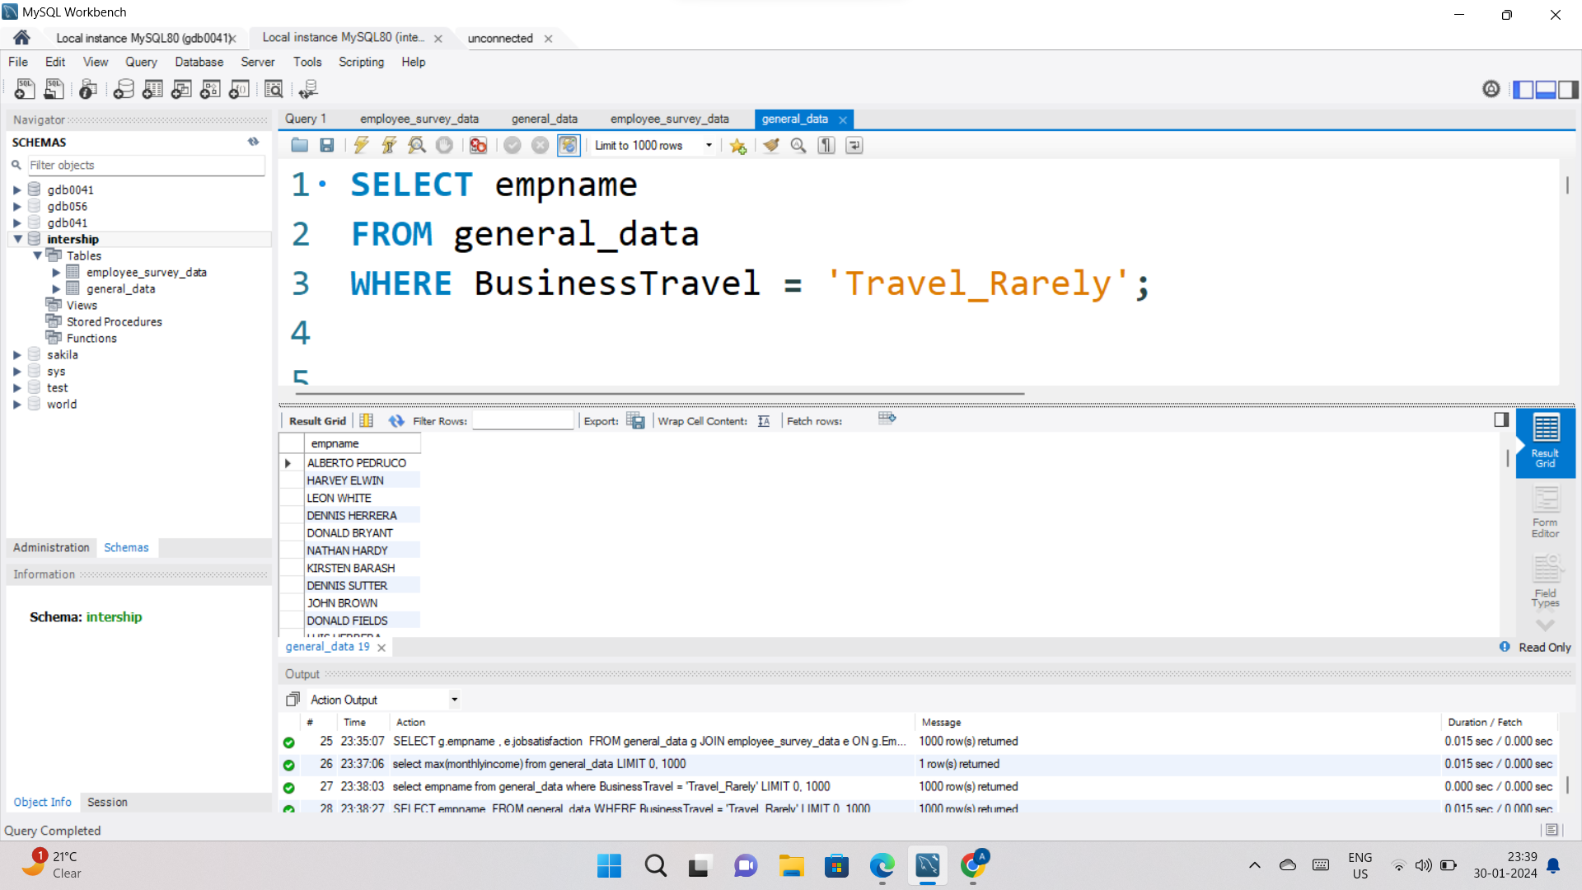
8. List employees who have 'Travel_Rarely' as their BusinessTravel type.

Slide 10
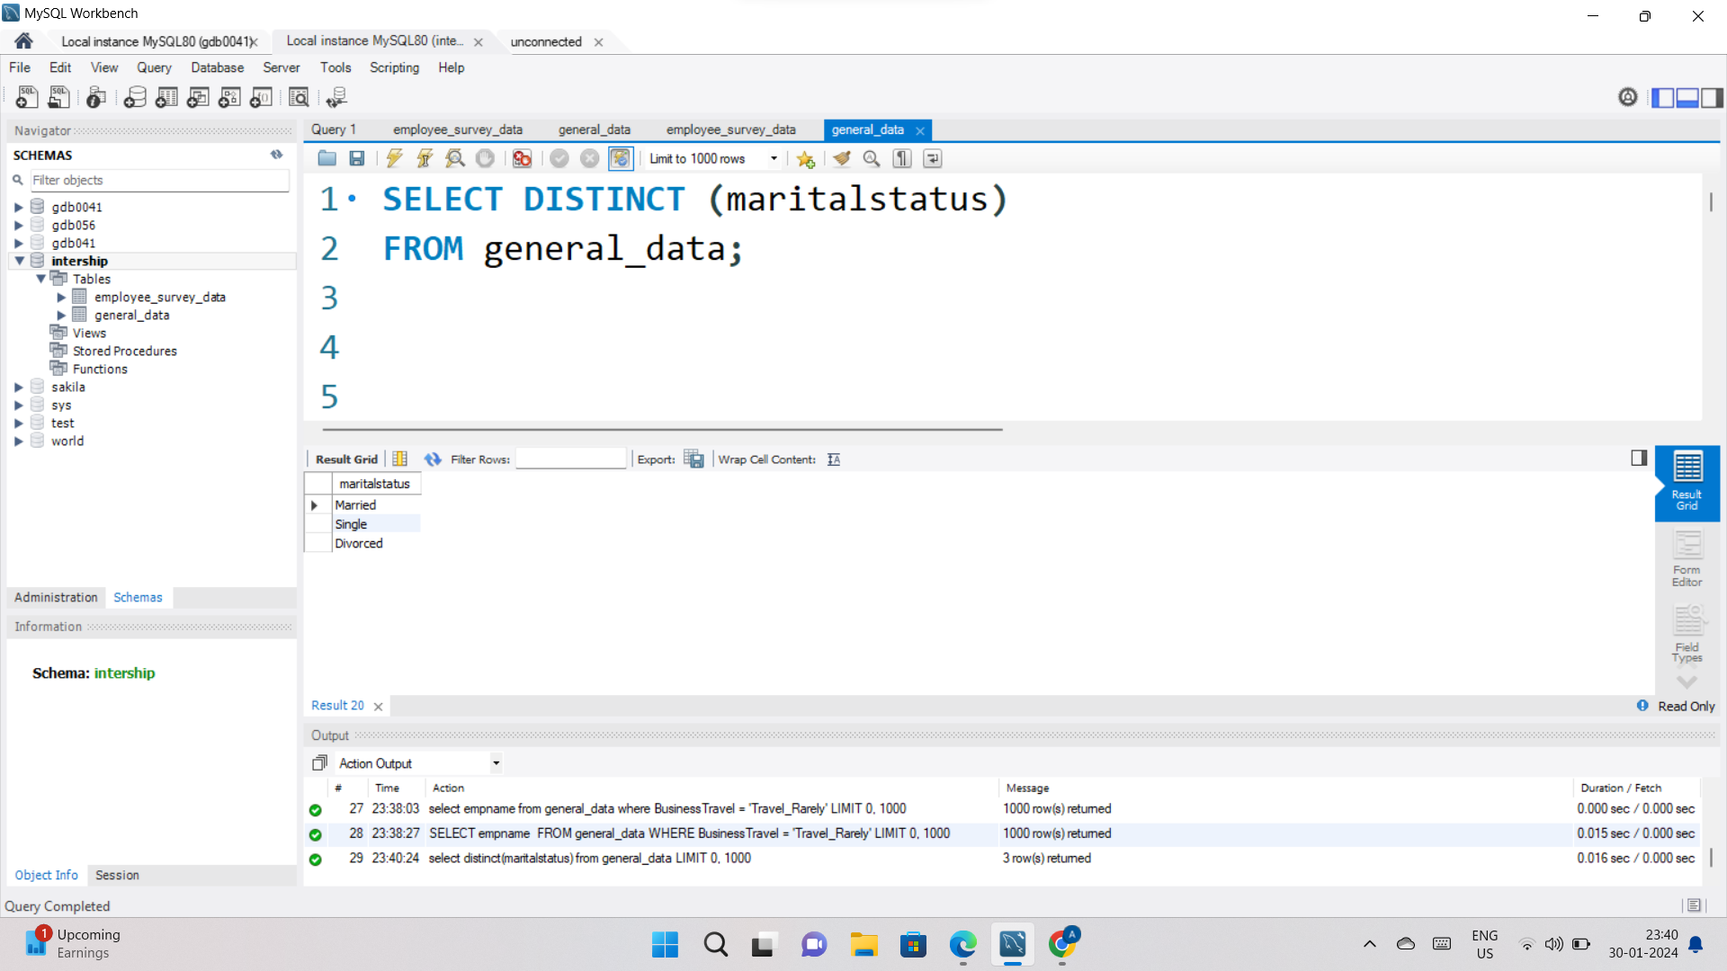
9. Retrieve the distinct MaritalStatus categories in the dataset.

Slide 11
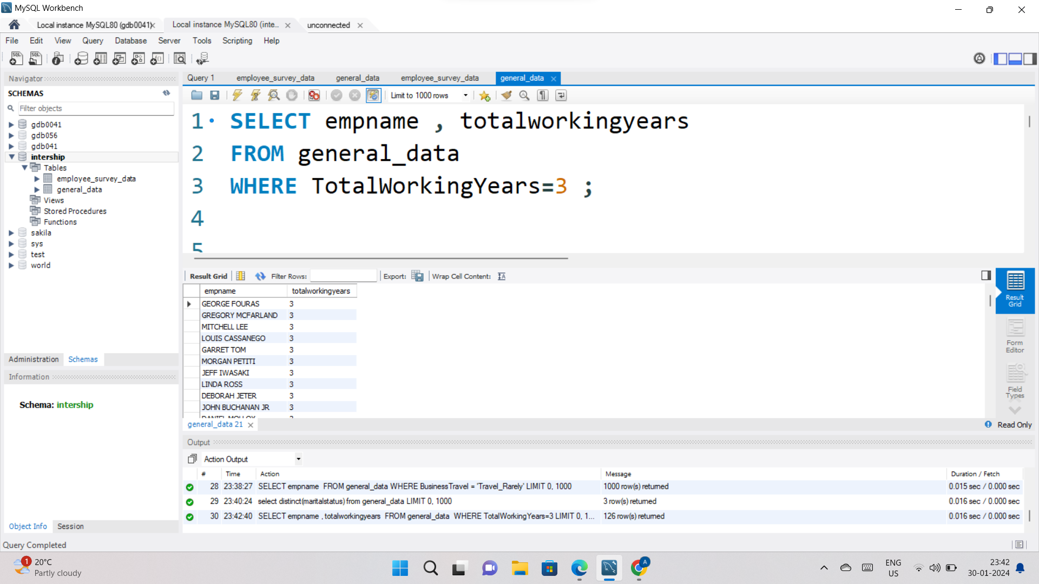
10. Get a list of employees with more than 2 years of work experience but less than 4 years in their current role.

Slide 12
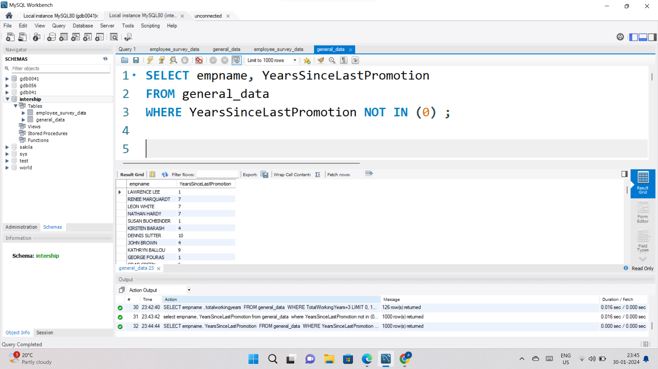
11. List employees who have changed their job roles within the company.

Slide 13
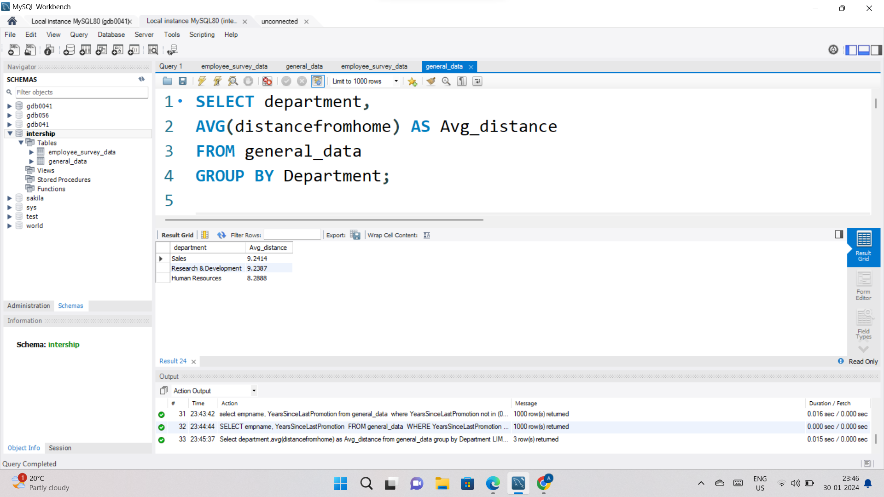
12. Find the average distance from home for employees in each department.

Slide 14
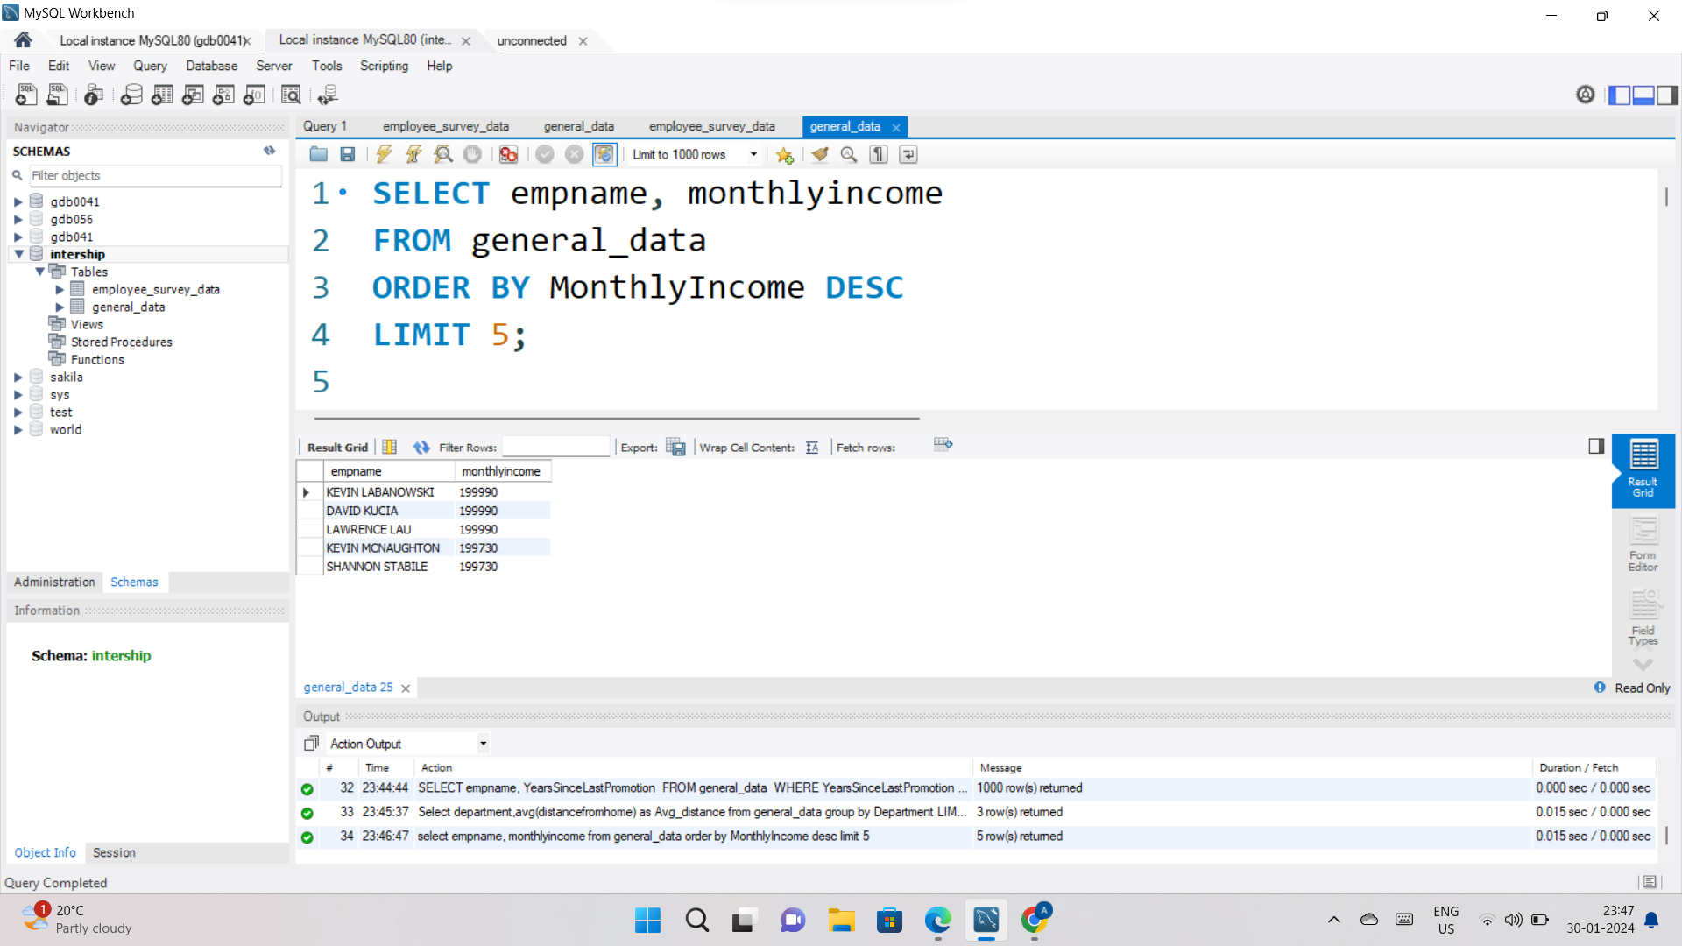
13. Retrieve the top 5 employees with the highest MonthlyIncome.

Slide 15
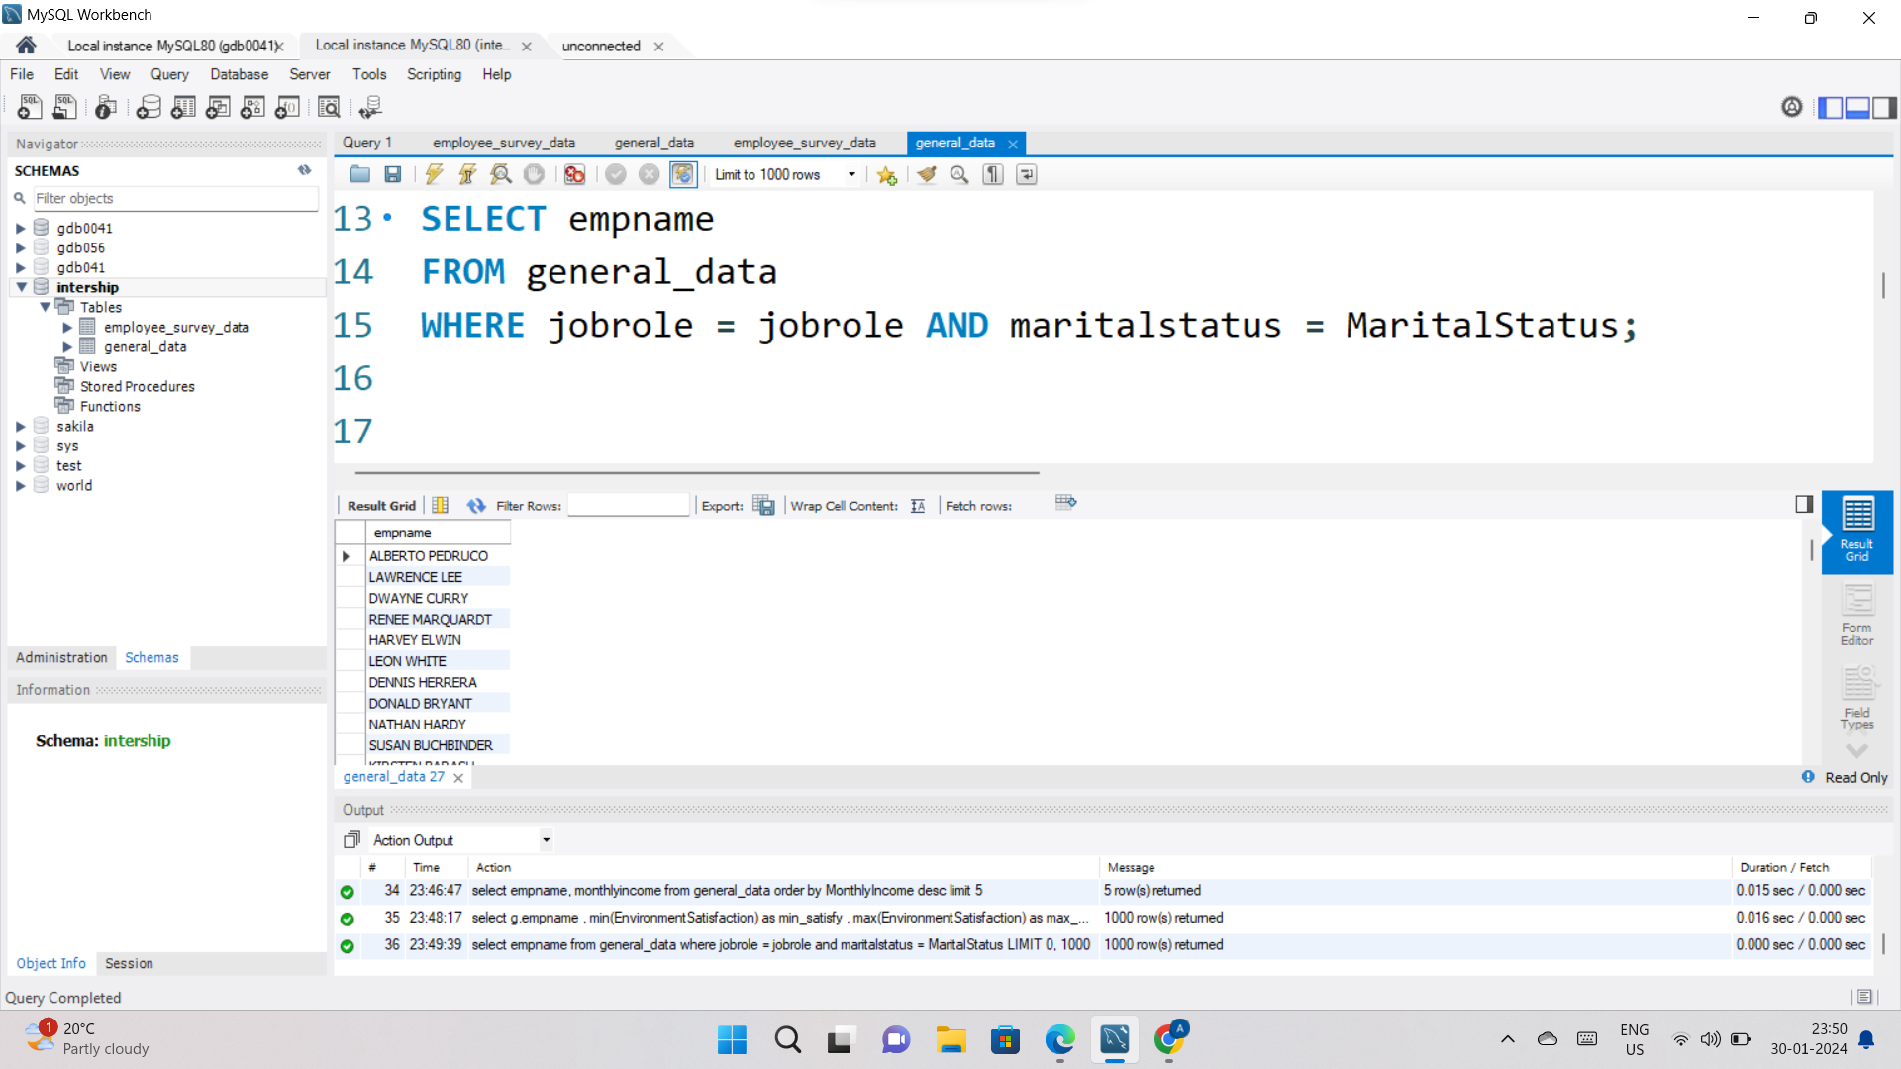
14. Find the employees who have the same JobRole and MaritalStatus.

Slide 16
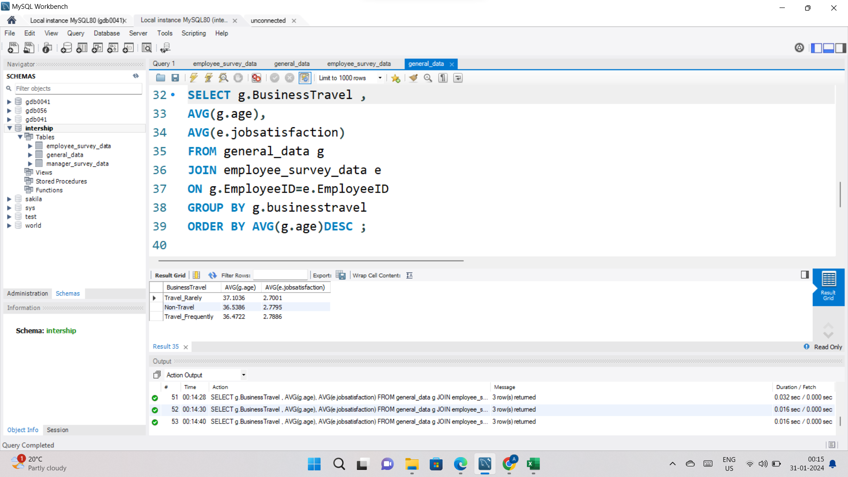
15. List the employees with the highest TotalWorkingYears who also have a Performance Rating of 4.

Slide 17
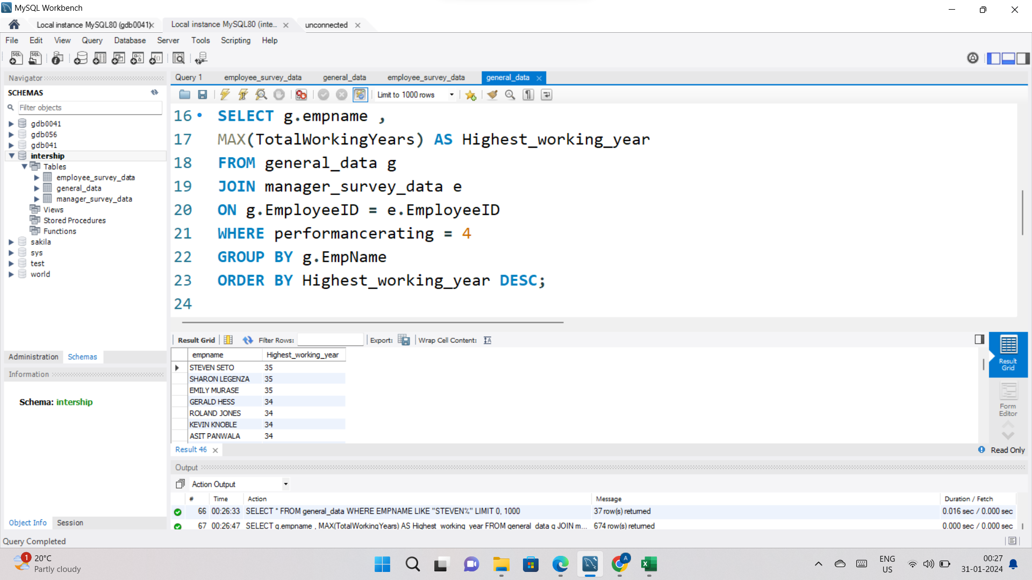
16. Calculate the average Age and JobSatisfaction for each BusinessTravel type.

Slide 18
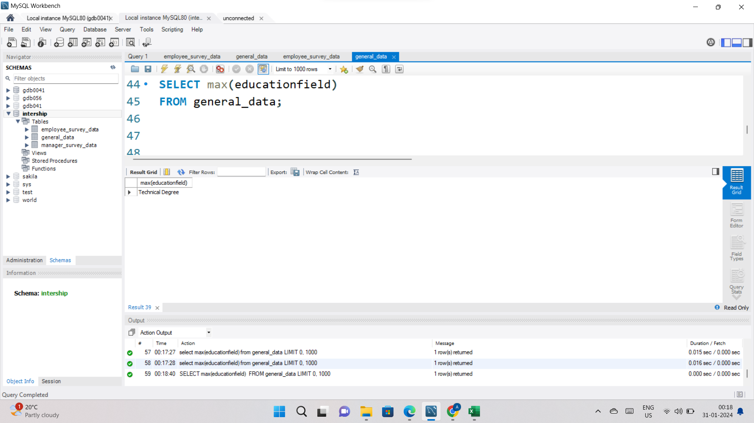
17. Retrieve the most common EducationField among employees.

Slide 19
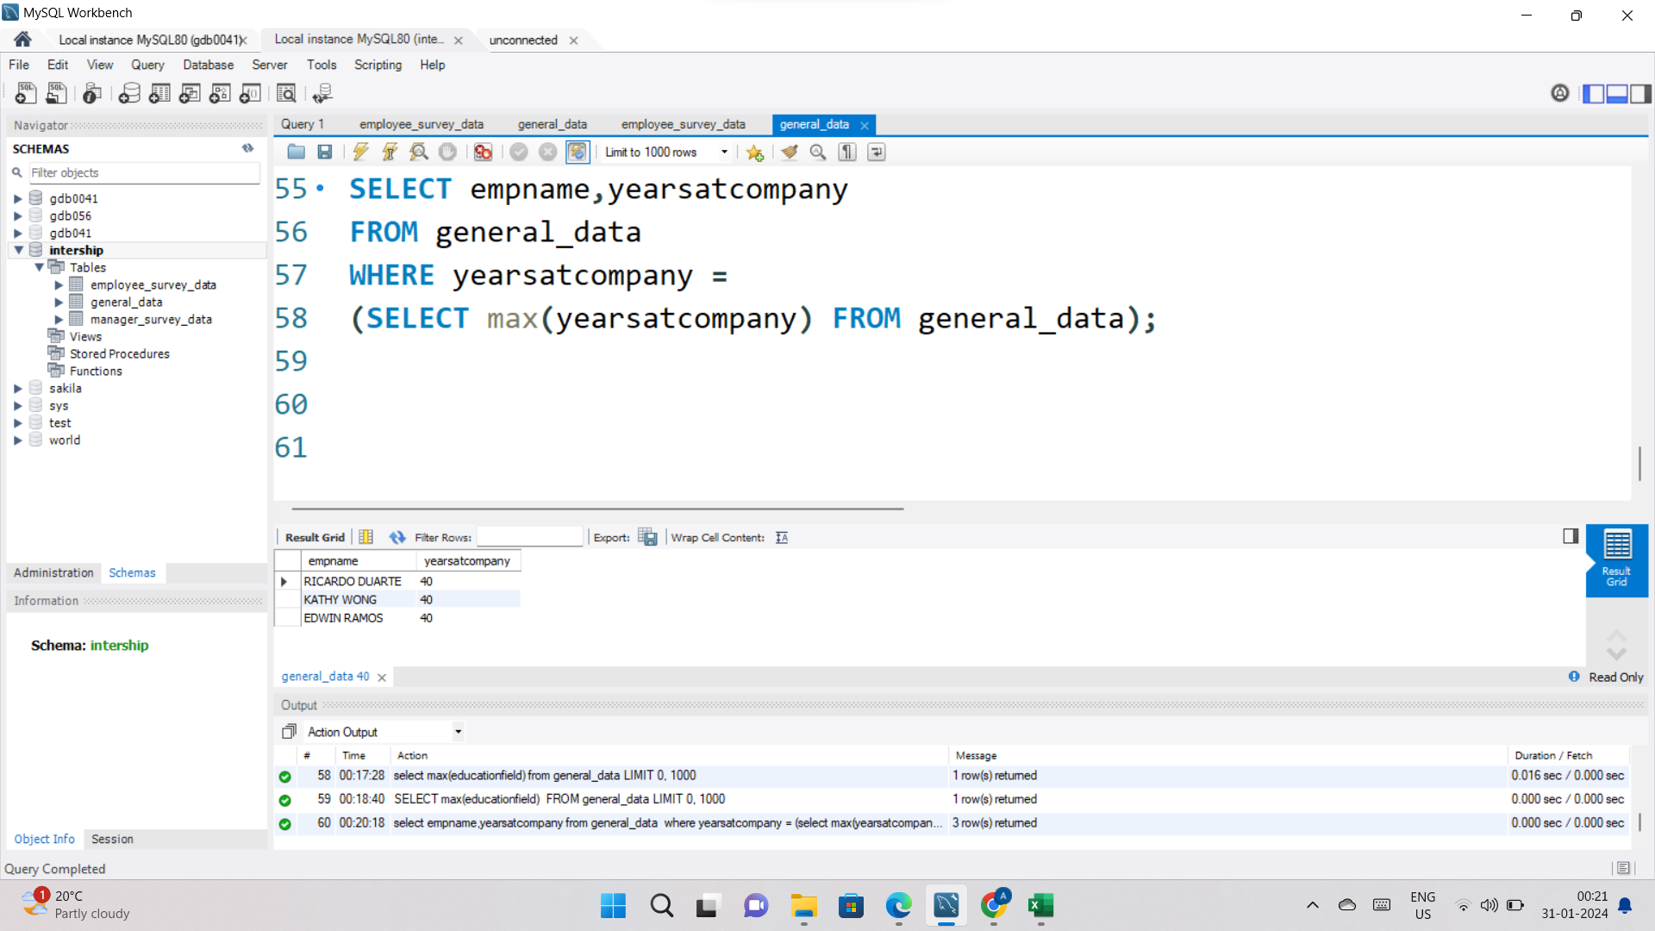
18. List the employees who have worked for the company the longest but haven't had a promotion.

Slide 20
Conclusion
The provided queries and analyses offer a comprehensive understanding of various facets within the employee dataset, encompassing both basic statistics and specific insights into employees' characteristics and experiences. The importance of understanding workforce composition, demographics, retention, departmental distribution, job satisfaction, salary structures, travel patterns, marital status, work experience, promotion trends, and performance analysis. Each of these aspects provides valuable information for effective workforce planning, resource allocation, and the development of tailored HR strategies. This wealth of data is crucial for organizations seeking to enhance their decision-making processes and refine policies to foster employee satisfaction and retention.
the focus shifts to the overarching significance of these analyses for the company. The detailed information extracted from the dataset contributes to strategic decision-making, guiding the organization in refining HR policies and implementing targeted interventions. By recognizing and addressing variations in satisfaction levels, tenure, and other factors, the company can create a more supportive and engaging work environment. Additionally, insights into career development, performance recognition, and educational backgrounds empower the organization to optimize talent acquisition and development strategies. Overall, the combination of these analyses serves as a powerful tool for organizations striving to boost employee satisfaction, retention, and overall organizational performance in an increasingly competitive job market.

Slide 21
THANK YOU
FOR YOUR ATTENTION

